Slide 1


Food Bacteria Classification from Chicken Rinse
Saif Ur Rehman Khan
Intelligent Network and Cooperative Computing Research Group
23, August 2023

Slide 2


Slide 3
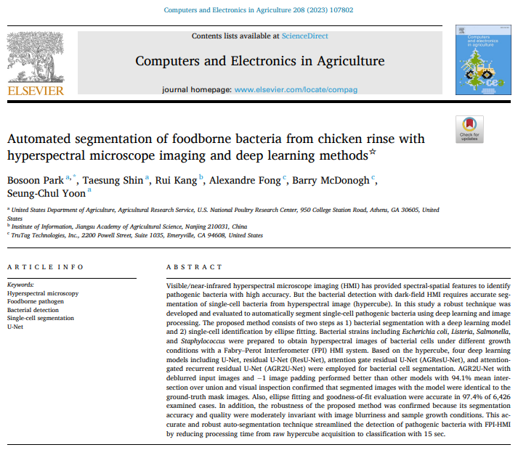

Slide 4
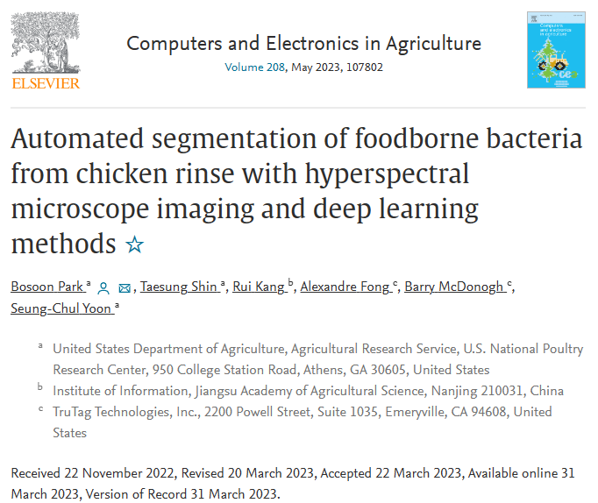

Slide 5

Background and Motivation
Introduction
Foodborne illness is a significant threat to food safety and public health, with food contamination by pathogenic bacteria being a leading cause.
The accurately characterizing the behavior of microorganisms in food is crucial for preventing and mitigating food safety issues.
Traditional methods for bacterial detection involve culturing microorganisms in growth media, which can take several days, or using polymerase chain reaction (PCR) methods that require expensive reagents.
Former Approach Problems
Optical techniques, such as hyperspectral microscope imaging (HMI) combined with deep learning (DL), have shown potential in improving bacterial detection.
HMI provides spectral-spatial features for accurate assessment of bacteria, while DL allows for non-vector inputs and better classification accuracy.
However, bacterial detection with dark-field HMI requires segmenting single-cell bacteria from hyperspectral images, which is time-consuming and inconsistent with manual method.
Previous automatic segmentation methods have not provided sufficient accuracy and robustness for dark-field hyperspectral images.
Notes:
Hyperspectral microscope imaging (HMI)

Slide 6
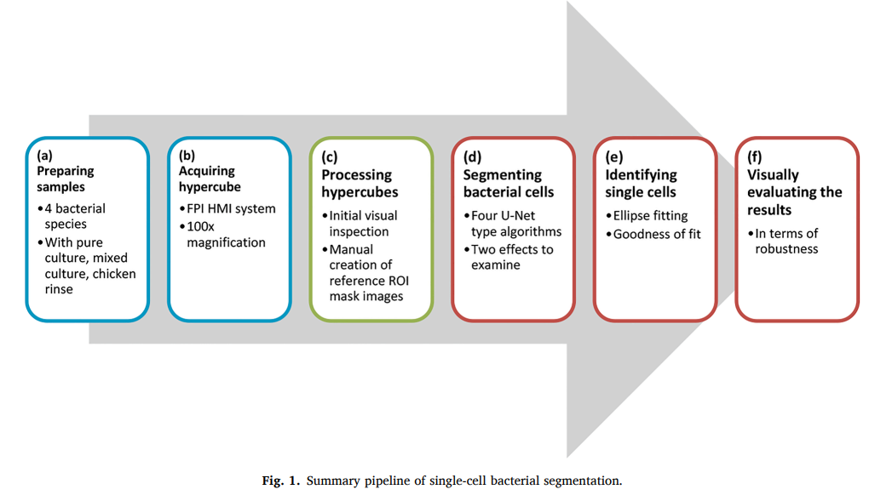
Background and Motivation
Contributions
In this research, author aimed to develop methods for the auto segmentation of single-cell bacteria in dark-field HMI hypercubes.
Objectives
1) To determine parameters for auto-segmentation through visual inspection of hypercubes, 2) to create reference mask images of the bacteria based on the requirements for each hypercube, 3) to develop four U-Net-based DL models for bacteria segmentation, 4) to build an algorithm to find single cells among segmented bacterial cells, and finally 5) to evaluate robustness and effectiveness of models for automated bacteria segmentation.
Fig 1: Summary pipeline of single-cell bacterial segmentation
Notes:
The proposed method involves two steps: bacterial segmentation using deep learning models (U-Net, ResU-Net, AGResU-Net, and AGR2U-Net) and single-cell identification through ellipse fitting .
The study evaluates the performance and robustness of the models using different growth conditions and image blurriness, achieving high accuracy in bacterial cell segmentation and identification .
The developed auto-segmentation technique streamlines the detection of pathogenic bacteria with HMI, reducing processing time from raw hypercube acquisition to classification [1].
The paper also mentions the preparation of samples of four bacterial species under different growth conditions, the creation of reference mask images, and the visual examination of the segmentation results [2].
The study highlights the limitations of manual segmentation methods and the need for high-quality automatic segmentation using deep learning models [3].
Overall, the paper presents a comprehensive approach for automated segmentation of single-cell bacteria using deep learning and image processing, demonstrating its accuracy and robustness in detecting pathogenic bacteria [1].

Slide 7
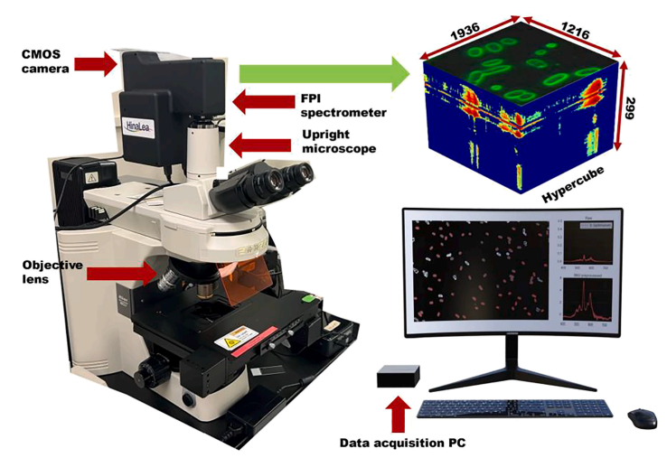
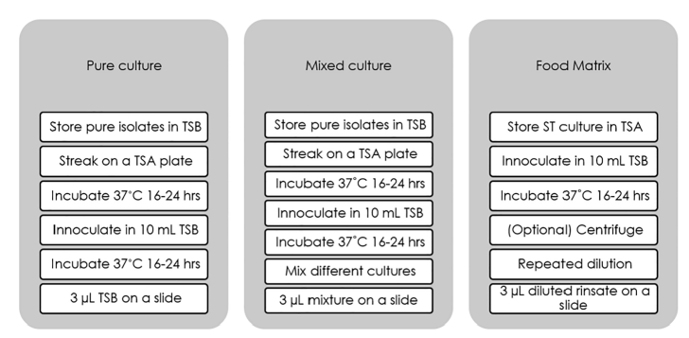
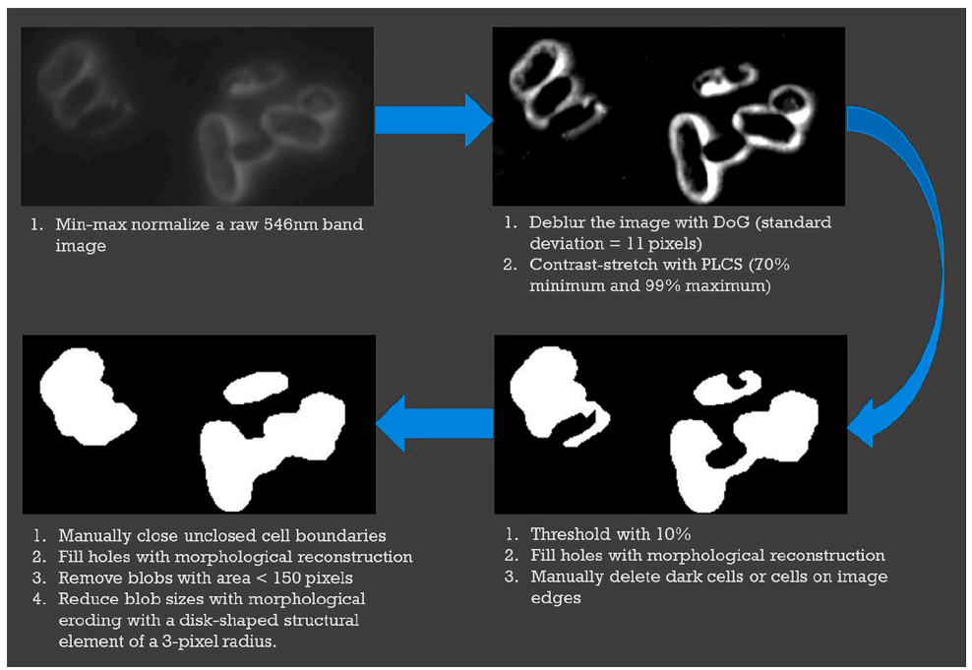
Data Acquisition Procedure
Fig 2: . Summary of three different procedures to prepare bacterial samples
Fig 3: Components of the FPI HMI system to collect hypercubes of bacterial cells.: (a) CMOS Camera, (b) Hypercube, (c) Objective Lens, (d) Data Acquisition PC as output.

Slide 8
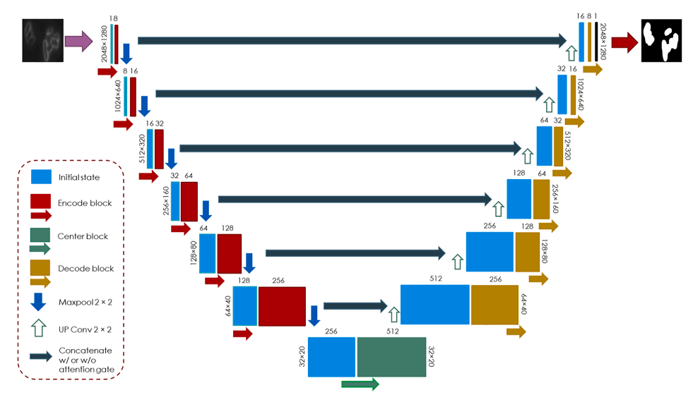
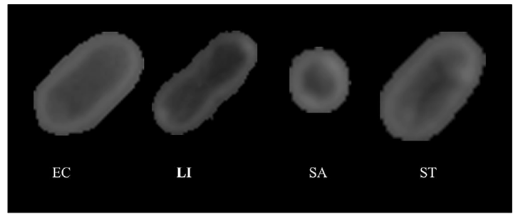
Four U-Net-Type Architecture
E. coli
Listeria innocua
Staphylococcus aureus
Salmonella Typhimurium
Fig 5: Comparison of four different bacterial strains single cells
Fig 4: Summary architecture and data flow of four U-Net-type models (U-Net, ResU-Net, AGResU-Net, and AGR2U-Net)
Notes:
Fig. 5 shows the architec- ture of the four U-Net-type models with seven floors. A U-Net-type model consists of four components: 1) encoder blocks, 2) decoder blocks, 3) a center block, and 4) skip paths concatenating data between each pair of encoder and decoder blocks.
The purpose of the encoder block was to extract summarized (or compressed) features for segmentation. Decoder blocks use to reconstruct the cell mask images with the compressed features.
The skip paths was to avoid feature loss from multiple encoding and decoding by combining encoded data with decoded data.

Slide 9
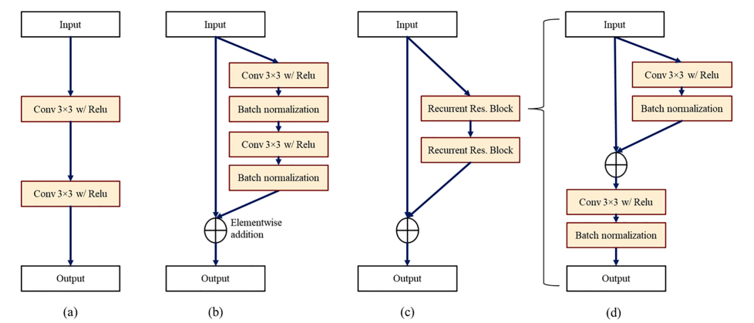
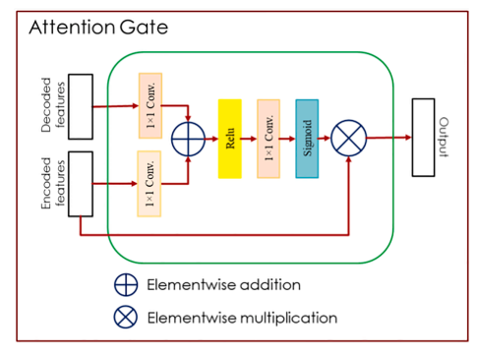
Four U-Net-Type Architecture
Fig 6: Common structures of encoder, decoder, and center blocks in (a) U-Net, (b) ResU-Net and AGResU-Net, (c) AGR2U-Net. (d) Detail of the recurrent residual block used in (c).
Fig 7: The architecture of the attention gate in AGResU-Net and AGR2U-Net
Notes:
Utilization of four deep learning models (U-Net, ResU-Net, AGResU-Net, and AGR2U-Net) for bacterial cell segmentation . 1) U-Net, 2) residual U-Net (ResU-Net), 3) attention-gated residual U-Net (AGResU-Net), and 4) attention-gated recurrent residual U-Net (AGR2U-Net)
U-Net extracts features from input data with two consecutive blocks of 3 × 3 convolutional kernel and rectified linear unit (ReLU) activation (Fig. 6a). ResU-Net and AGResU-Net adds a skip connection between the input and output of the two blocks (Fig. 6b) for better accuracy without vanishing gradient issues in operations. The two blocks of 3 × 3 convolutional kernel, ReLU, and batch normalization in AGResU-Net were replaced with two recurrent residual (R2) blocks for AGR2U-Net (Fig. 6c) to perform better in encoding/decoding. Fig. 6d the structure of the R2 block that consists of a single convolutional block after a residual block with another convolutional block and a skip connection. This R2 block was modified from the original proposal based on hyperparameter optimization in this study.
The goal of the attention gate was to highlight an essential part of the features for improved segmentation

Slide 10
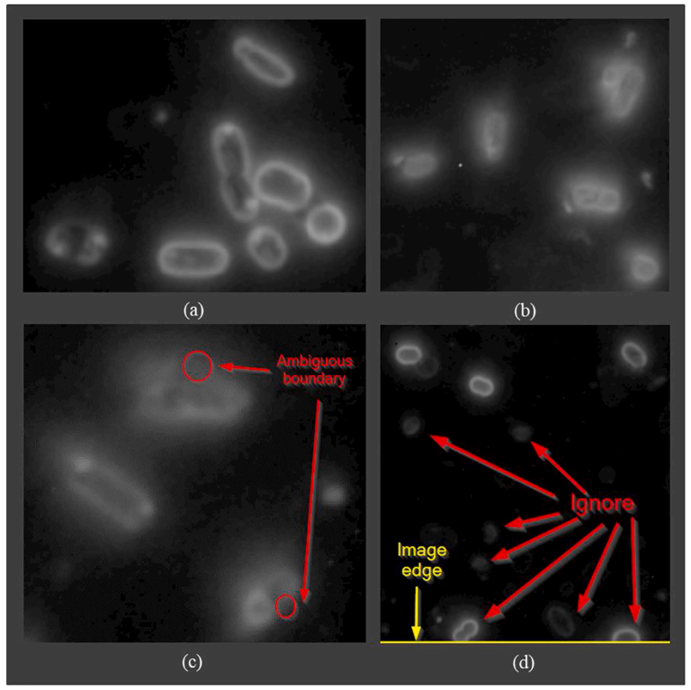
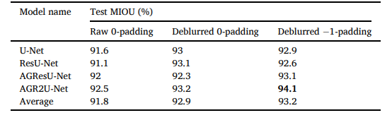
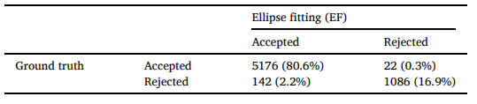
Results of the U-Net-Type Architecture
Table 1: Results of bacterial cell segmentation with deep learning models under different conditions: input image source (raw and deblurred) and image padding (0 and − 1).
Table 2: Confusion matrix of single-cell selection between the EF method and ground truth.
Fig 8: Images for visual inspection of raw 546 nm band images for bacterial cell segmentation; (a, b) show different blurriness over different images, (c) light
scattering issues around bright cell boundaries, (d) cells with low intensity and incomplete part of cells in image edges.

Slide 11
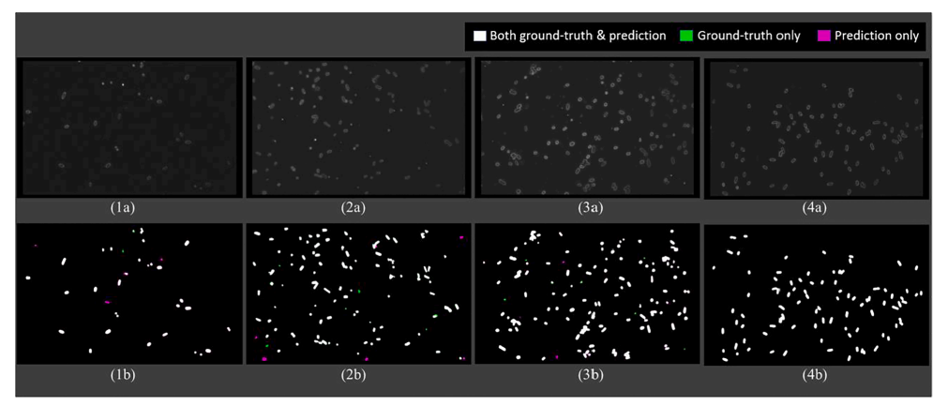
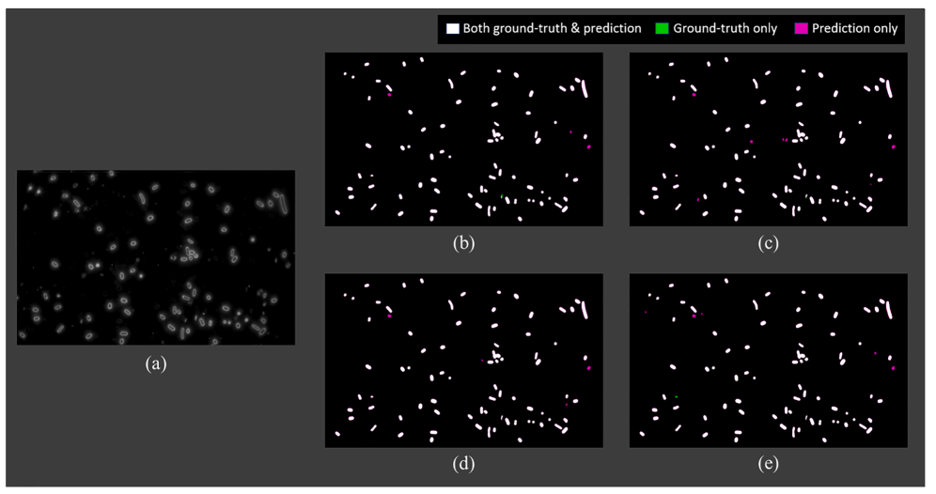
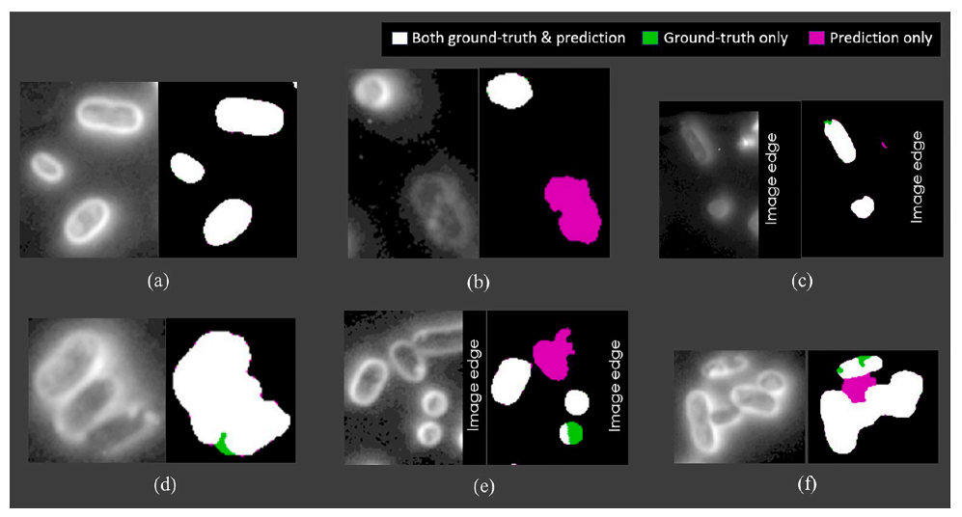
Results of the U-Net-Type Architecture
Fig 9: (a, top) and corresponding mask images (b, bottom) from ground-truth and trained AGR2U-Net; (1) mixed culture (EC + LI + SA + ST, 87.8% MIOU), (2) mixed culture (LI + SA + ST, 90.9% MIOU), (3) mixed culture (EC + LI + SA + ST, 95.7% MIOU), (4) mixed culture (LI + ST, 99.1% MIOU);
Fig 10: (a) raw 546 nm band image with the lowest MIOUs (86–88%) from the four models, (b) the predicted image from U-Net with 88.4% MIOU, (c) the predicted from ResU-Net with 86.4% MIOU, (d) the predicted from AGResU-Net with 87.3% MIOU, (e) the predicted from AGR2U-Net with 87.6% MIOU;
Fig 11: Magnified parts of 546 nm band images (left) and their corresponding segmentation difference between ground truth and AGR2U-Net (right). (a, c, d) from a mixed culture image with EC and LI, (b, e, f) from two images of mixed culture with EC, LI, and SA.

Slide 12
Limitations
There are several limitations exist in the introduced framework.
Studies are required to identify and optimize those hyperparameters to improve the proposed method for single-cell segmentation of pathogenic bacteria.
Extremely blurry cells could still degrade pixel classification results from the AGR2U-Net model, indicating a limitation in accurately segmenting all single cells in an image.
The paper mentions that the proposed method relies on the use of hyperspectral microscope imaging (HMI), which may not be readily available or accessible in all laboratory settings.
The study primarily focuses on the segmentation and identification of single-cell pathogenic bacteria, and it does not address the classification or detection of specific bacterial species.
More research about XAI needs to be done to fully understand and develop robust DL model for identification of bacterial cell viability.

Slide 13
Thank You for your Attention

Slide 14
TransLR-Net: Enhancing Classification Accuracy of Live and Dead Foodborne Bacteria in Hyperspectral Microscope Imagery
Classification Performance of Proposed TransLR-Net Model
Models | Precision | Recall | F1-Score | Accuracy
Vit-Large32 (Base) | 0.88 | 0.88 | 0.88 | 0.88
ResNet101 (Base) | 0.90 | 0.89 | 0.90 | 0.89
VitL32 (Base)+ ResNet101 (Base) | 0.91 | 0.91 | 0.91 | 0.91
TransLR-Net | 0.93 | 0.92 | 0.93 | 0.93
The Proposed TransLR-Net Model achieved highest as compare to sub-models

Slide 15
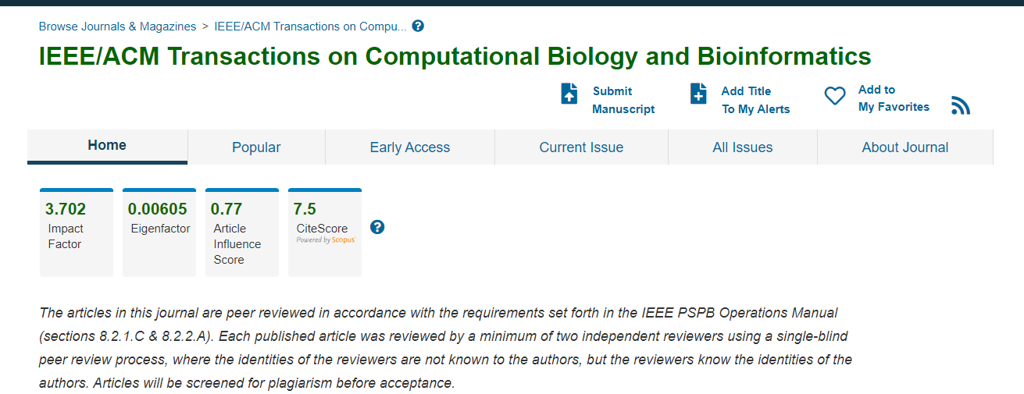
Journal to Submitting Paper

